Slide 1
PAINT INSTRUCTION SYSTEM
PAINT SHOP
EQUIPMENT INSTRUCTION
WORKING INSTRUCTION
PROGRESS

Slide 2
INTRODUCTION PURPOSE 導入目的
Instruction
Online
作業指示：塗装工程作業指示/Finishingライン作業指示(Body Shop)
Work Instruction :Paint shop work instruction/Finishing line work instruction (Body Shop)
Progress
Visualization
仕掛かり台数表示(WBS , PAINT , PBR)
遅れ表示
The number display between station
Delay display of production

Slide 3



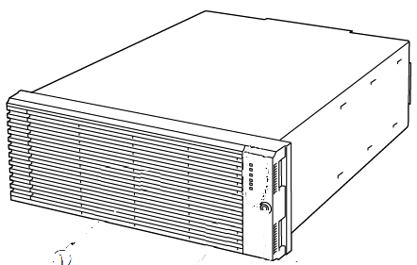



構成 COMPOSITION
Skip / Insert operations, production order changes.
Creation
Progress Server
AS/400
Progress Monitor
Body shop
Paint shop
Schedule
Instruction
Data
Instruction
Parameter
Pass results(PBR/On)
Ope. Terminal
Production Data
Schedule
Instruction
Data
Instruction
data
RFID Writing data
Body Shop
Instruction Server
Paint Shop
Progress Server
Body shopの生産順番で、塗総Shop用の指示データを作成する。
指示データは、PLCから指示される。
ステーション別に車両の進捗を管理する。
ステーションの進捗は、PCに表示される。
Data is written in order of producing Body shop.
The instruction data for paint Shop is made.
The instruction data is directed from PLC.
The progress of the vehicle is managed according to the station.
The progress of the station is displayed in PC.
Progress/
Instruction
Instruction Display
Instruction Display

Slide 4
BODY SHOP
Metal Finishing Line～WBS

Slide 5


DATA INPUT(SKIT NO,) -FINISHING ON-
RFID TAG Writing:
CAB&PUBX Loading Stage
PAINT SHOP SCHDULE MONITOR
INSTRUCTION SCHEDULE
Seq.
Lot
MODEL
Lot
Unit
BLOCK
Seq.
RESULT
IMPORT CODE
COLOR
C
OLOR NAME
0001
ID
CODE
No.
MODEL
CODE
0002
098
000XXX00
100
01
2010 0608 08:15 32
TFR86HPMSC
0
64
A
RC WHITE #064
0003
098
000XXX00
100
02
2010 0608 08:16 48
TFR87HPMSC
0
64
ARC WHITE #064
0004
098
000XXX00
100
03
2010 0608 08:17 21
TFR88HPMSC
0
64
ARC WHITE #064
Body Shop: FINISHING LINE
0005
098
000XXX00
100
04
2010 0608 08:18 36
TFR89HPMSC
0
64
ARC WHITE #064
0006
098
000XXX00
100
05
2010 0608 08:20 03
TFR90HPMSC
0
64
ARC WHITE #064
0007
098
000XXX00
100
06
2010 0608 08:21 08
TFR91HPMSC
0
64
ARC WHITE #064
0008
098
000XXX00
100
07
2010 0608 08:22 30
TFR92HPMSC
0
64
ARC WHITE #064
0009
098
000XXX00
100
08
2010 0608 08:28 46
TFR93HPMSC
0
64
ARC WHITE #064
To
Finishing Line
0010
098
000XXX00
100
09
2010 0608 08:32 12
TFR94HPMSC
0
64
ARC WHITE #064
0011
098
000XXX00
100
10
2010 0608 08:33 58
TFR95HPMSC
0
64
ARC WHITE #064
0012
128
010XXX01
105
01
E1003001
001
2010 0608 08:35 03
TFR96HPMSC
5
05
R
OYAL GRAY MET.
PUBX
CAB
0013
128
010XXX01
105
02
E1003001
002
TFR97HPMSC
5
05
ROYAL GRAY MET.
0014
128
010XXX01
105
03
E1003001
003
TFR98HPMSC
5
05
ROYAL GRAY MET.
0015
128
010XXX01
105
04
E1003001
004
TFR99HPMSC
5
05
ROYAL GRAY MET.
Compare:Lot No.&Unit
Write Terminal
0016
128
010XXX01
105
05
E1003001
005
TFR99HPMSC
5
05
ROYAL GRAY MET.
0017
351
000XXX00
120
06
E1003001
006
TFR99HPMSC
5
05
ROYAL GRAY MET.
0018
351
000XXX00
120
07
TFR99HPMSC
6
89
O
MEGA WHITE PEARL
0019
351
000XXX00
120
08
TFR99HPMSC
6
89
O
MEGA WHITE PEARL
CAB&PUBX
Unloading CP
0020
351
000XXX00
120
09
TFR99HPMSC
6
89
O
MEGA WHITE PEARL
0021
351
000XXX00
120
10
TFR99HPMSC
6
89
O
MEGA WHITE PEARL
0022
351
000XXX01
120
11
TFR99HPMSC
6
89
O
MEGA WHITE PEARL
0023
351
000XXX02
120
12
TFR99HPMSC
6
89
O
MEGA WHITE PEARL
0024
351
000XXX03
120
13
TFR99HPMSC
6
89
O
MEGA WHITE PEARL
0025
351
000XXX04
120
14
TFR99HPMSC
6
89
O
MEGA WHITE PEARL
0026
351
000XXX05
120
15
TFR99HPMSC
6
89
O
MEGA WHITE PEARL
Instruction Display
0027
351
000XXX06
120
16
TFR99HPMSC
6
89
O
MEGA WHITE PEARL
0028
351
000XXX07
120
17
TFR99HPMSC
6
89
O
MEGA WHITE PEARL
0029
351
000XXX08
120
18
TFR99HPMSC
6
89
O
MEGA WHITE PEARL
0030
351
000XXX09
120
19
TFR99HPMSC
6
89
O
MEGA WHITE PEARL
0031
351
000XXX10
120
20
TFR99HPMSC
6
89
O
MEGA WHITE PEARL
0032
351
000XXX11
120
21
TFR99HPMSC
6
89
O
MEGA WHITE PEARL
351
000XXX12
120
22
TFR99HPMSC
6
89
O
MEGA WHITE PEARL
F1:CHANGE
F2:
F3:
F4:
F5:
F6:
F7:PREVIOUS
F8:NEXT
F9:RELOAD
F10:SEARCH
F11:
F12:MENU
In the first stage of "Finishing Line" , data is written PLC.
Compared Lot No. the same and then automatically writes.

Slide 6

WORK INSTRUCTION -FINISHING LINE-
Finishing Lineの指示工程は、3箇所
  Stage：FRT DR/HOOD/キャッチャー
指示データは、要求した車型に対して指示される。
Body shop Instruction App.
The instruction process of Finishing Line is three places.
Stage:
  FRT DOOR/HOOD/Catcher
The instruction data directs the data of the demanded vehicle type.
Demand data :Model Code + Lot No. + SEQ
Instruction data
Data request
Instruction Display
Finishing Line stage

Slide 7

WBS ON/OFF
WBS On/Off 通過実績を取得
Pass results of “WBS On/Off” are acquired.
Paint production App.
Pass result
Existing
WBS entrance
WBS exit
Instruction Display
Instruction Display

Slide 8
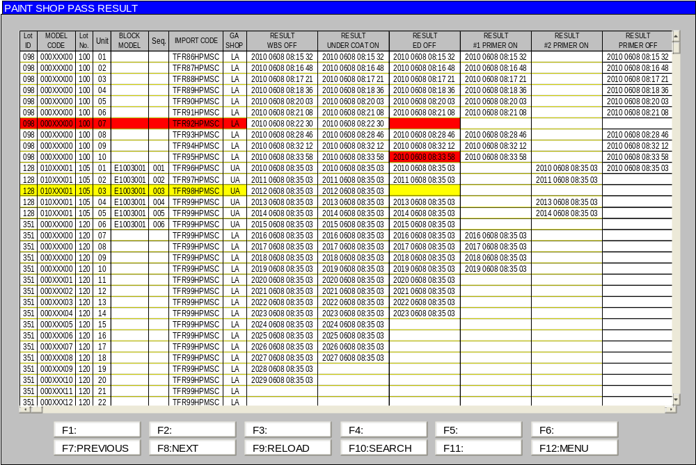
SCREEN :PASS RESULTS
Pass results
  Stage of WBS ON-OFF

Slide 9
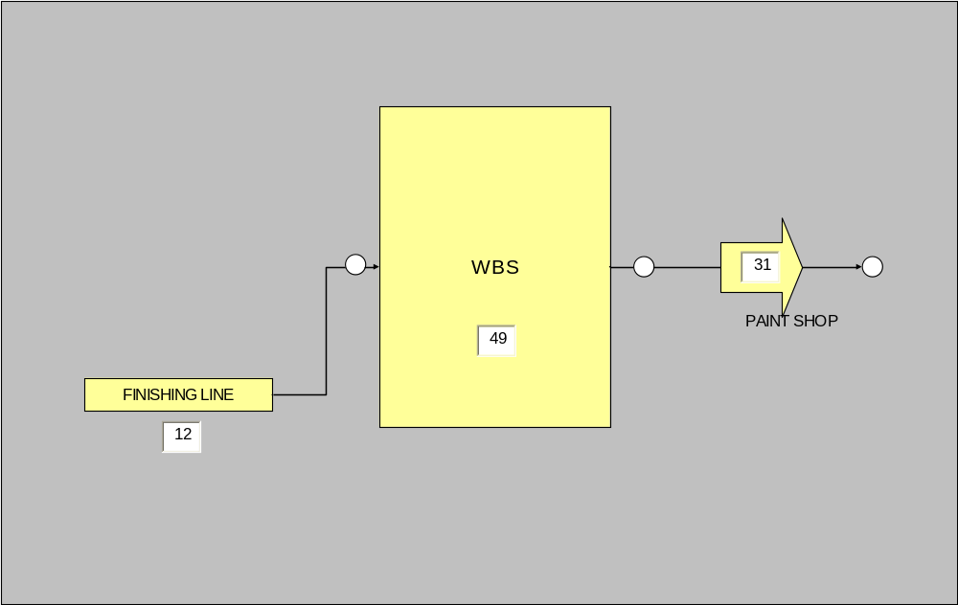
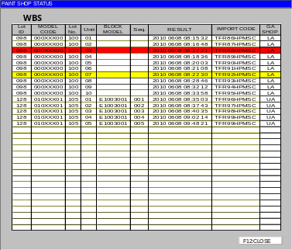
SCREEN: PROGRESS
Click

Slide 10
PAINT SHOP
INSTRUCTION & PASS RESULT

Slide 11
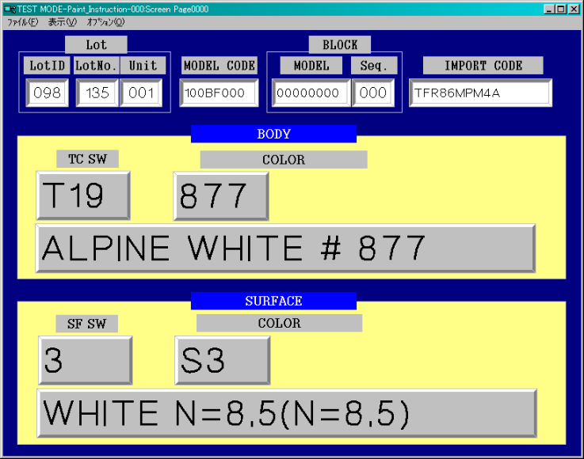
INSTRUCTION/PASS RESULTS
To
AS/400:Pass results
Pass results
Instruction Display
The data input(SKIT No,) .
It is received DATA by a server.

Slide 12
SCREEN :PASS RESULTS
Pass results
  Stage of paint shop ON-OFF

Slide 13
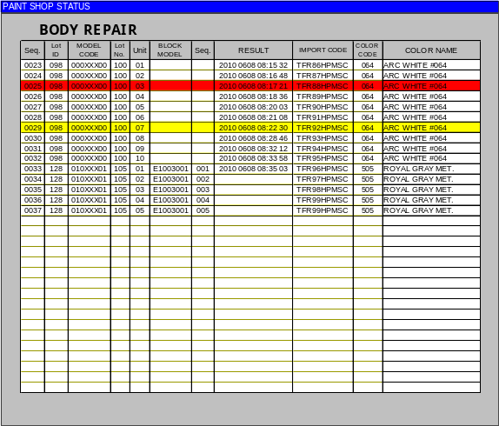
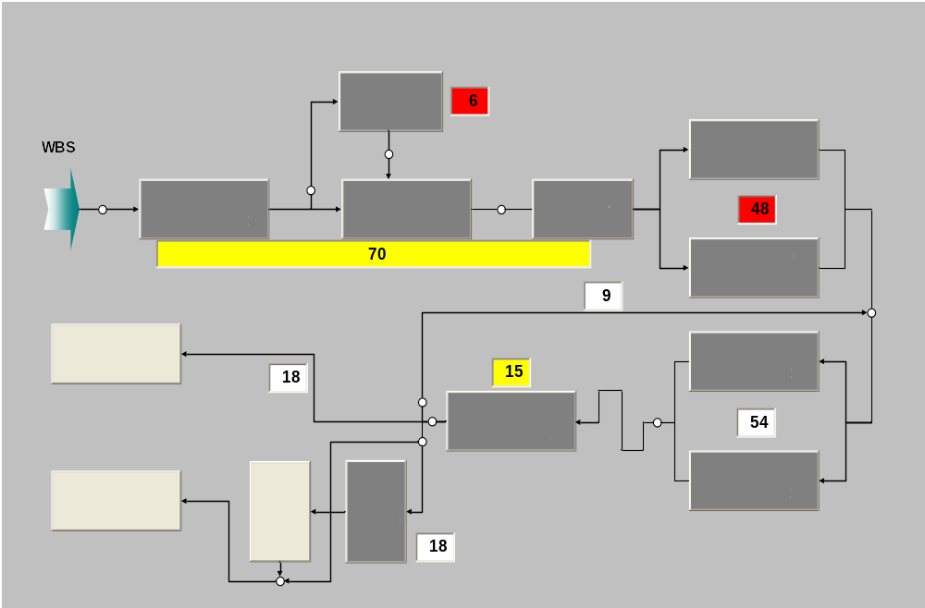
SCREEN :PROGRESS
Click
in → out
設定時間以上の遅れ
in → out
予定時刻より遅れ
Number of stock between stations
Stock results of station
Process street time

Slide 14
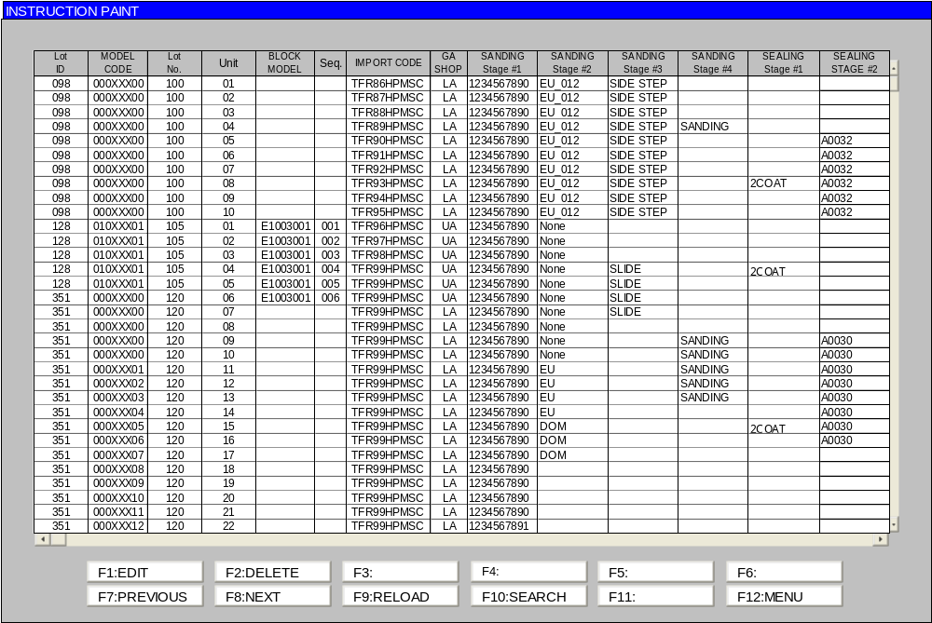
SCREEN :INSTRUCTION DATA
Display of instruction data

Slide 15
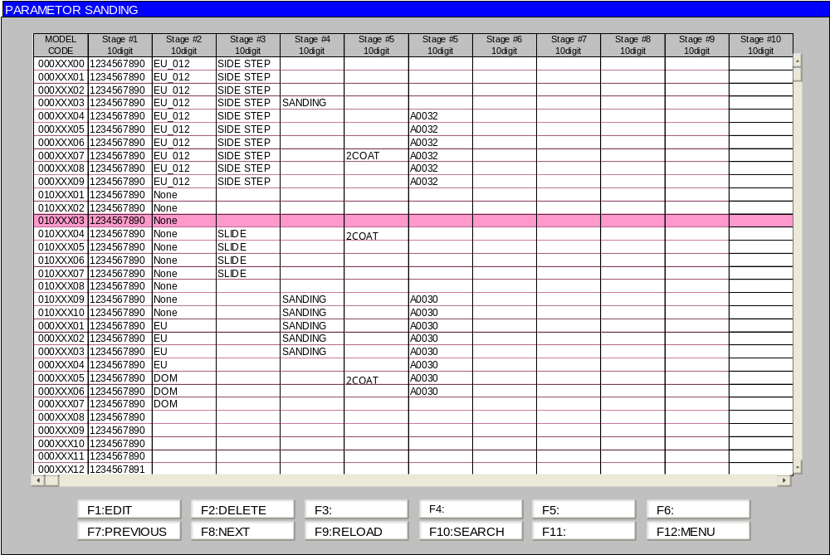
SCREEN :PARAMETER SETTING
EDITE DATA
Key: Model Code (wild-card is also necessary. )
Parameter size: 10digit*10stage
Block (instruction): 4 number

Slide 16
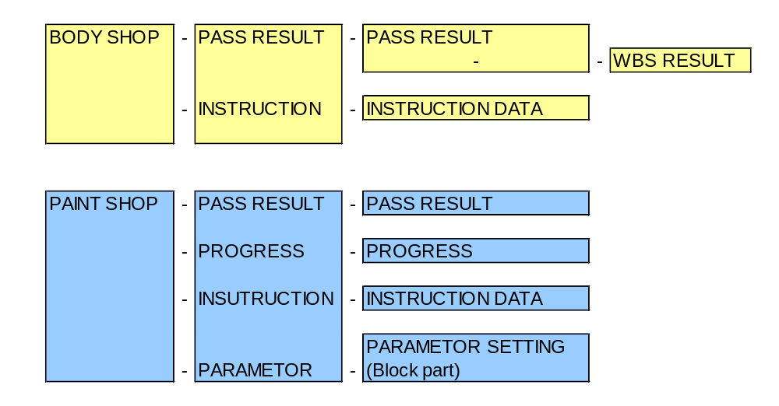
SCREEN TRANSITION

Slide 17
AS/400 INTERFACE

Slide 18
AS/400 INTERFACE -PRODUCTION DATA-
Production information reception
  生産情報/塗装情報を受信
  ファイル受信手順は、Body/Frameと同様
  AS/400⇔PaintProgressServerは、HULFTでデータ送受信
  Production information/painting information is received.
  The file reception procedure : as well as Body/Frame.
  Data sending and receiving of AS/400⇔PaintProgressServer with HULFT

Slide 19



HULFT I/F -PRODUCTION DATA-
AS/400
Paint Progress Server
Transmission processing
SEND START
配信開始
SEND
配信
Job ID
SEND DATA
GENERATE
配信データ生成
File reception
FILE SEND STAND BY
ファイル配信処理
FILE RECEIVE
ファイル受信
Error
Instruction
DB
Y
Deletion: Transmission file
RECEIVE FILE DELETE
受信ファイル削除
NORMAL
受信正常
SEND FILE DELETE
配信ファイル削除
SEND OF CONFIRM THE RECEIVE FILE
受信確認ファイル送信
Reception is normal

Slide 20
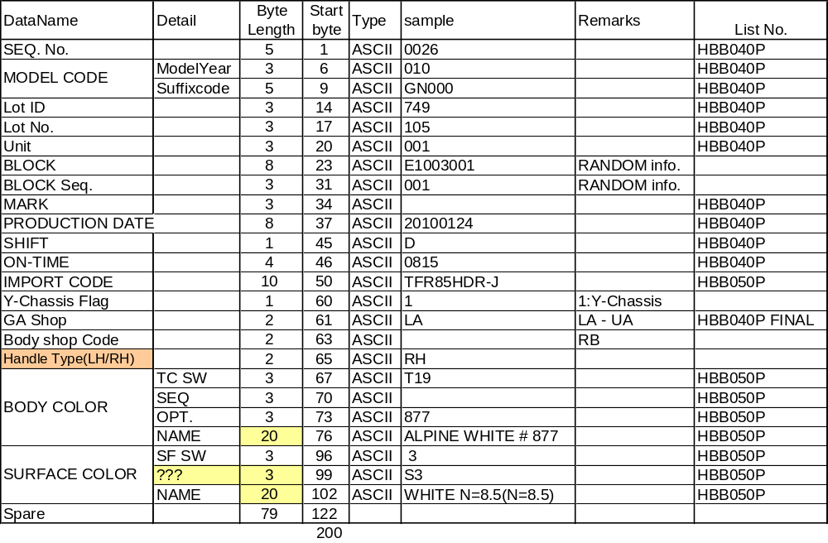
I/F DATA LAYOUT -PRODUCTION DATA-
The specification of Header/Trailer : as well as Body.

Slide 21
AS/400 INTERFACE –RANDOM RESULT TRANSMISSION (PBR ON)
UA pass results transmission
  生産管理情報として、建て直しレーン（PBR）の前で、車両通過実績を送信する。
  AS/400⇔PaintProgressServerは、HULFTでデータ送受信
  送信するデータは、Randomのみ
  The vehicle street results are transmitted as production management information in front of rearrange lane (PBR).
  Data sending and receiving of AS/400⇔PaintProgressServer with HULFT
  Only Random : the transmitted data.
  PBR: Painted Body Rearrange

Slide 22

RANDOM RESULT TRANSMISSION (PBR ON)
Result (to AS/400)
PBR Lane
INSPECTION
SPOT REPAIR
UA Line PBS
Traverser

Slide 23
HULFT I/F RANDOM RESULT TRANSMISSION (PBR ON)
AS/400
Paint RFID-TAG Progress Server
Transmission processing
PBR On
SEND DATA GENERATE
配信データ生成
File reception
PBR On results file transmission
FILE RECEIVE
ファイル受信
Delivery results file
The transmission
配信実績ファイル送信
PBR On results file
RESULT DATA
実績データ
受信正常
Reception is normal
DELETE OF CONFIRM
THE RECEIVE FILE
配信実績ファイル削除
Delete:PBR On results file

Slide 24
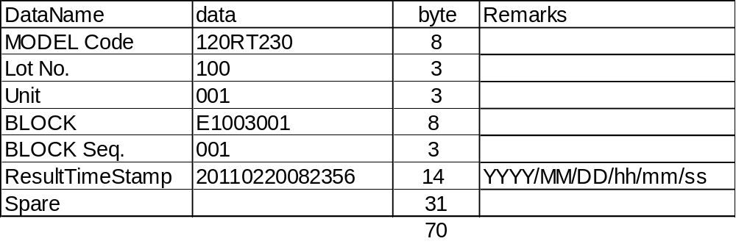
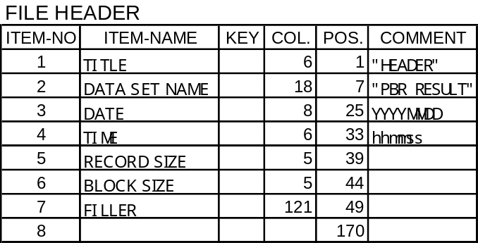
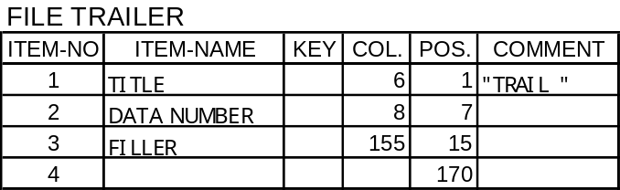
I/F DATA LAYOUT RANDOM RESULT TRANSMISSION (PBR ON)
Data Part
Filler Part

Slide 25
ABILITY
データ保管台数 1日分×10日分
書き込みサイクル 1分/台
PLCクライアント 40台 max
生産情報受信（AS/400） 1回/日
実績送信(AS/400） 発生都度（約 5分/回）

